Slide 1
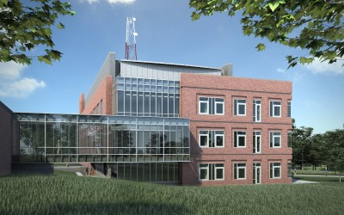
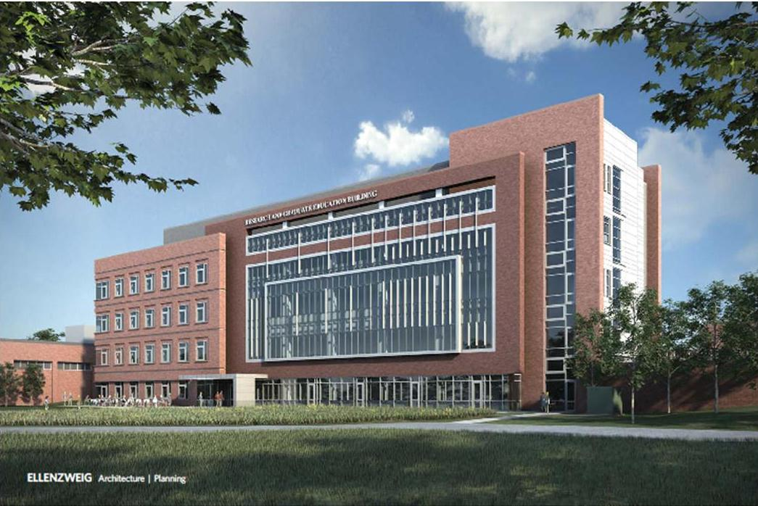
NEOMED Research and Graduate Education Building + Comparative Medical Unit Expansion
the Northeast Ohio Medical University Campus
Rootstown, Ohio
Image © <www.neomed.edu>
Image © <www.crystaldiagnostics.com>
Sam Bridwell, BAE Mechanical Option Advisor: Dr. Freihaut
Notes:
Introduction

Slide 2
Table of Contents
Construction Management Breadth
Introduction
Project Overview
Existing Systems
Proposal
Depth: Cogeneration Plant Implementation
Breadth 1: Power Interconnect and Black Start Capability
Breadth 2: Alternate Project Delivery System
Final Recommendations
Conclusion/Acknowledgements
Final Recomendations
Project Overview
Existing Systems
Proposal
Mechanical Depth
Electrical Breadth
Existing Infrastructure
Decision Factors
Utility Data Analysis
Interconnection Laws and Standards
Background
Water-side HVAC
Proposal Components
Screening
Utility Interconnect Design
Research
Air-side HVAC
Configuration Analyses
Potential Benefits
Design Conditions
System Operation
Design Objectives
Further Expansion
Notes:
Project Overview: Project Background
Location
Campus
Phase 1
RGE
CMU
REDI-Zone
The Village
Phase 2
NEW
Phase 3

Slide 3
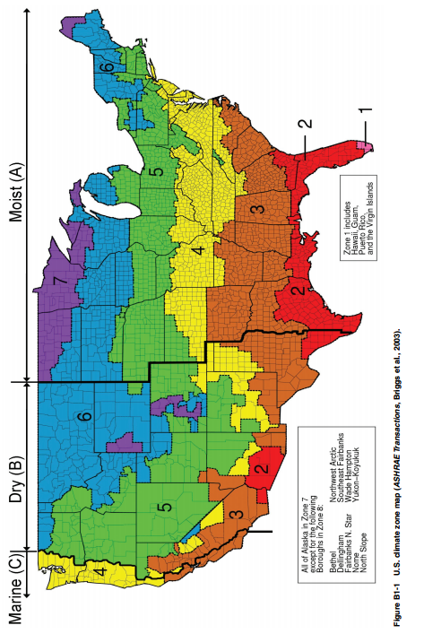
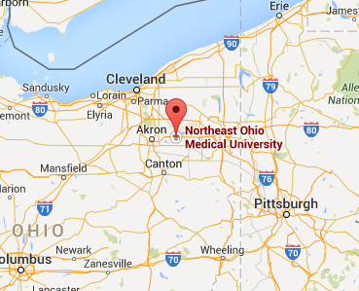
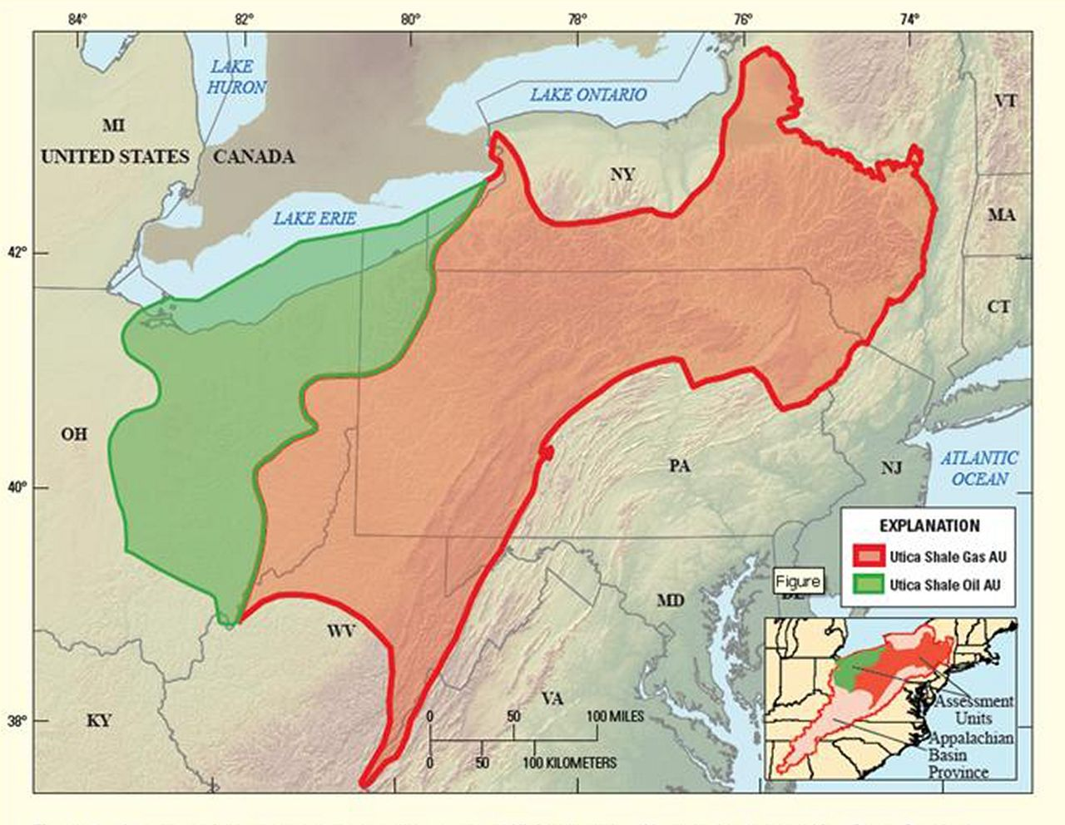
Table of Contents
Project Location
Introduction
Project Overview
Existing Systems
Proposal
Depth: Cogeneration Plant Implementation
Breadth 1: Power Interconnect and Black Start Capability
Breadth 2: Alternate Project Delivery System
Final Recommendations
Conclusion/Acknowledgements
Image © <http://upload.wikimedia.org/wikipedia/commons/thumb/b/b2/Utica_Shale_assessment_-_01.jpg/220px-Utica_Shale_assessment_-_01.jpg>
Image © ASHRAE Std. 90.1.5.1.4 Figure B1-1
Utica Shale Region
5A Cool and Moist
Notes:
Project Overview: Project Background
Location
Campus
Phase 1
RGE
CMU
REDI-Zone
The Village
Phase 2
NEW
Phase 3

Slide 4
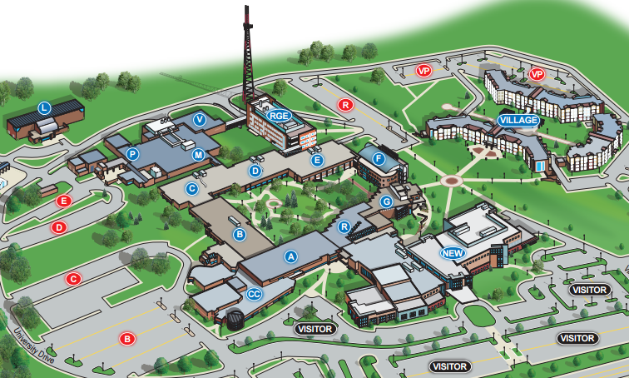
Table of Contents
Campus Map
Introduction
Project Overview
Existing Systems
Proposal
Depth: Cogeneration Plant Implementation
Breadth 1: Power Interconnect and Black Start Capability
Breadth 2: Alternate Project Delivery System
Final Recommendations
Conclusion/Acknowledgements
Image © <http://www.neomed.edu/about/pdfs/neomed-campus-map.pdf>
Notes:
Project Overview: Project Background
Location
Campus
Phase 1
RGE
CMU
REDI-Zone
The Village
Phase 2
NEW
Phase 3

Slide 5
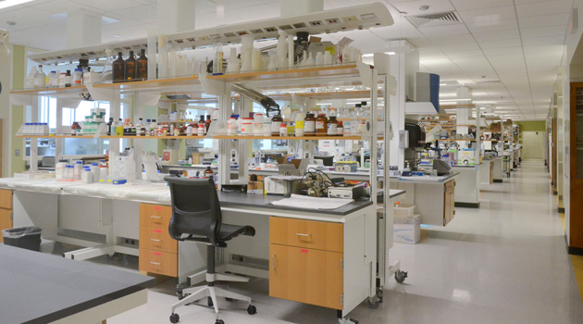
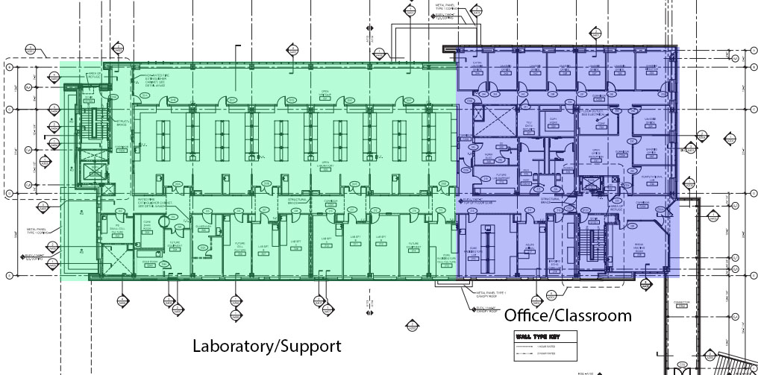
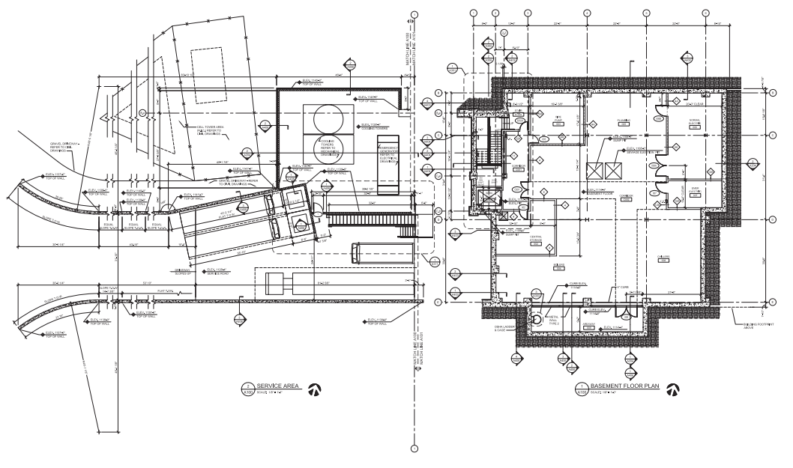
Table of Contents
Phase 1
Research and Graduate Education Building
Introduction
Project Overview
Existing Systems
Proposal
Depth: Cogeneration Plant Implementation
Breadth 1: Power Interconnect and Black Start Capability
Breadth 2: Alternate Project Delivery System
Final Recommendations
Conclusion/Acknowledgements
Image © <http://www.ruhlin.com/highered-neomedrgecmu>
Image © <http://www.neomed.edu/about/pdfs/neomed-campus-map.pdf>
Notes:
Project Overview: Project Background
Location
Campus
Phase 1
RGE
CMU
REDI-Zone
The Village
Phase 2
NEW
Phase 3

Slide 6
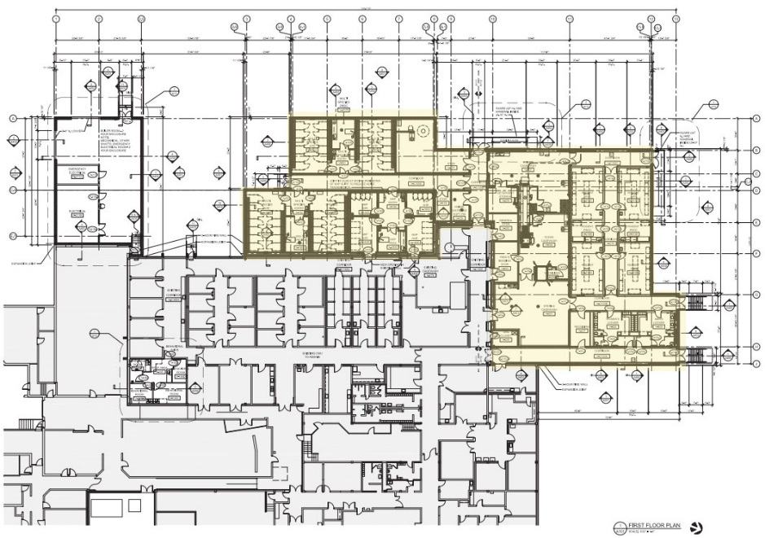
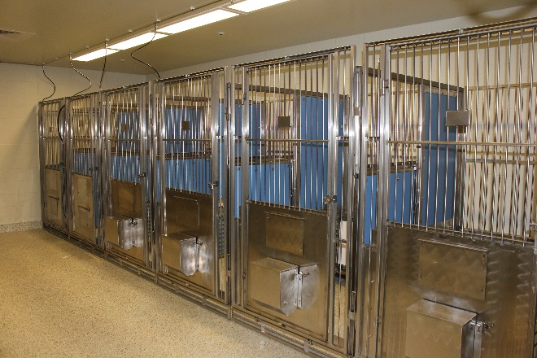
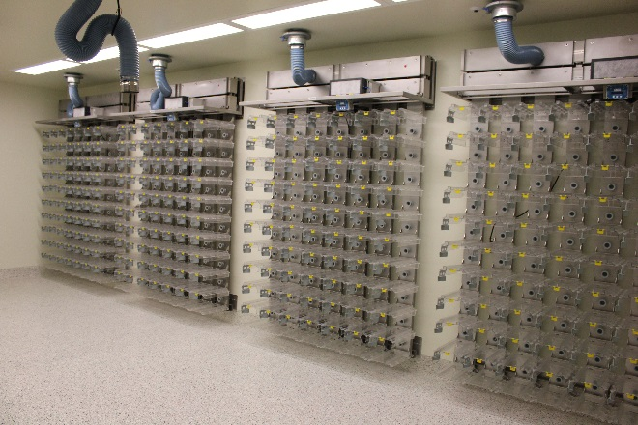
Table of Contents
Phase 1
Comparative Medical Unit Expansion
Introduction
Project Overview
Existing Systems
Proposal
Depth: Cogeneration Plant Implementation
Breadth 1: Power Interconnect and Black Start Capability
Breadth 2: Alternate Project Delivery System
Final Recommendations
Conclusion/Acknowledgements
Image © Scheeser Buckley Mayfield LLC
REDI-Zone
Image © Scheeser Buckley Mayfield LLC
Image © <http://www.neomed.edu/about/pdfs/neomed-campus-map.pdf>
Notes:
Project Overview: Project Background
Location
Campus
Phase 1
RGE
CMU
REDI-Zone
The Village
Phase 2
NEW
Phase 3

Slide 7
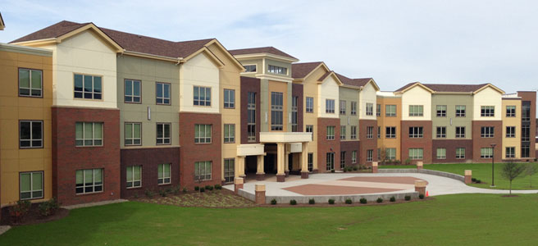
Table of Contents
The Village
Introduction
Project Overview
Existing Systems
Proposal
Depth: Cogeneration Plant Implementation
Breadth 1: Power Interconnect and Black Start Capability
Breadth 2: Alternate Project Delivery System
Final Recommendations
Conclusion/Acknowledgements
Image © <www.neomed.edu>
Image © <http://www.neomed.edu/about/pdfs/neomed-campus-map.pdf>
Notes:
Project Overview: Project Background
Location
Campus
Phase 1
RGE
CMU
REDI-Zone
The Village
Phase 2
NEW
Phase 3

Slide 8
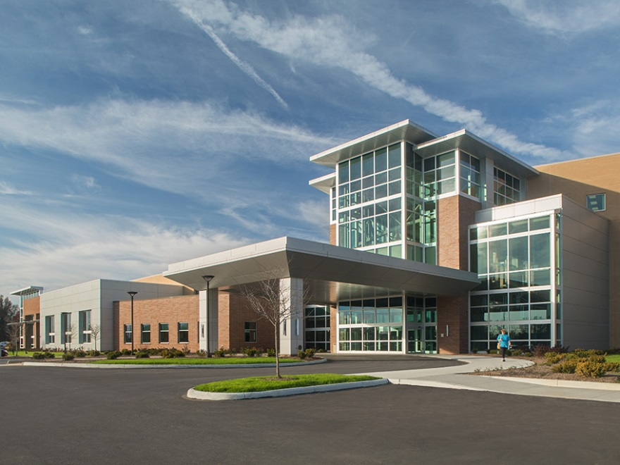
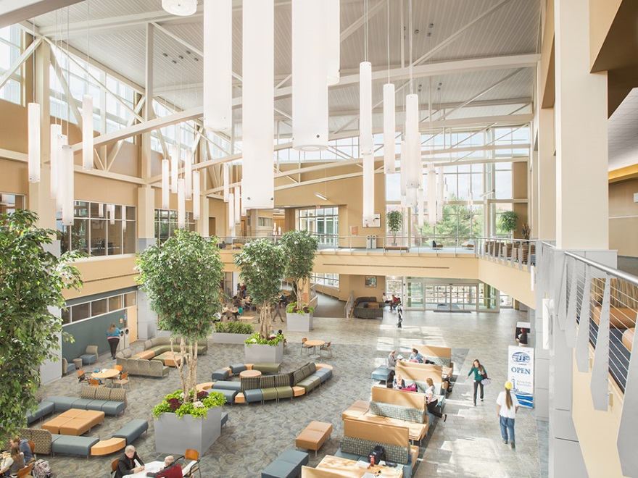
Table of Contents
Phase 2
Introduction
Project Overview
Existing Systems
Proposal
Depth: Cogeneration Plant Implementation
Breadth 1: Power Interconnect and Black Start Capability
Breadth 2: Alternate Project Delivery System
Final Recommendations
Conclusion/Acknowledgements
Image © <http://www.ruhlin.com/highered-neomedhwmec>
Image © <http://www.ruhlin.com/highered-neomedhwmec>
NEOMED Education and Wellness Center
Image © <http://www.neomed.edu/about/pdfs/neomed-campus-map.pdf>
Notes:
Project Overview: Project Background
Location
Campus
Phase 1
RGE
CMU
REDI-Zone
The Village
Phase 2
NEW
Phase 3

Slide 9
Table of Contents
Existing Infrastructure
Introduction
Project Overview
Existing Systems
  Existing Infrastructure
  Water-side HVAC
  Air-side HVAC
  Design Conditions
  Design Objectives
Proposal
Depth: Cogeneration Plant Implementation
Breadth 1: Power Interconnect and Black Start Capability
Breadth 2: Alternate Project Delivery System
Final Recommendations
Conclusion/Acknowledgements
Main HW/CW Plant
High-Pressure Steam Plant
Image © <http://www.neomed.edu/about/pdfs/neomed-campus-map.pdf>
Notes:
Project Overview: Project Background
Location
Campus
Phase 1
RGE
CMU
REDI-Zone
The Village
Phase 2
NEW
Phase 3

Slide 10
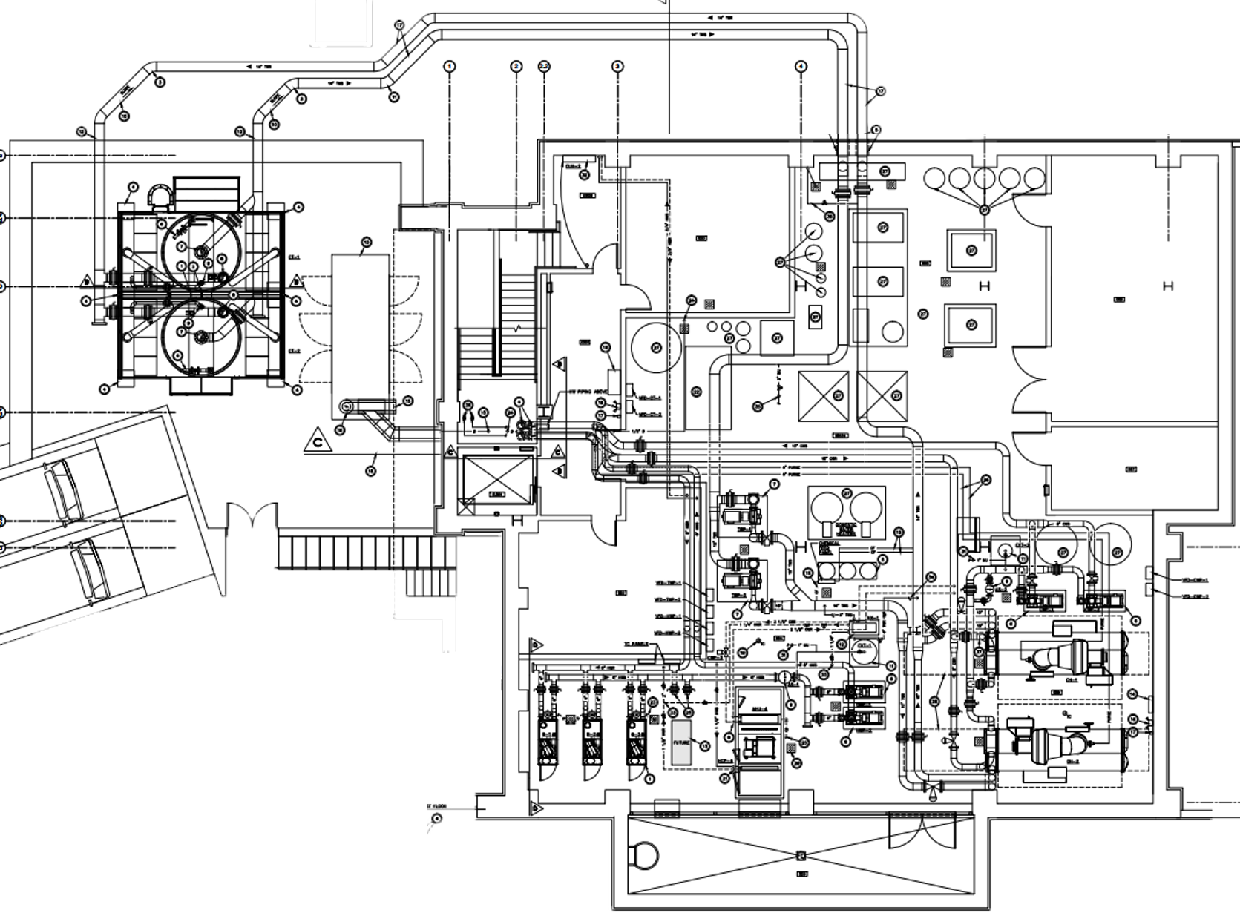
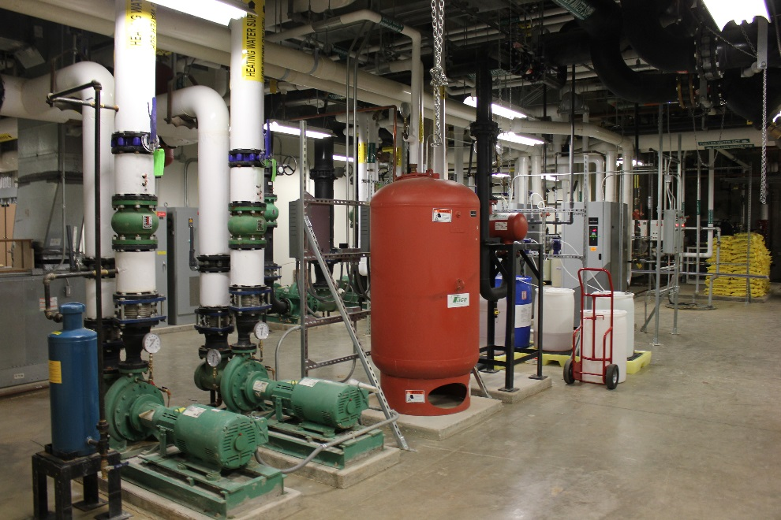
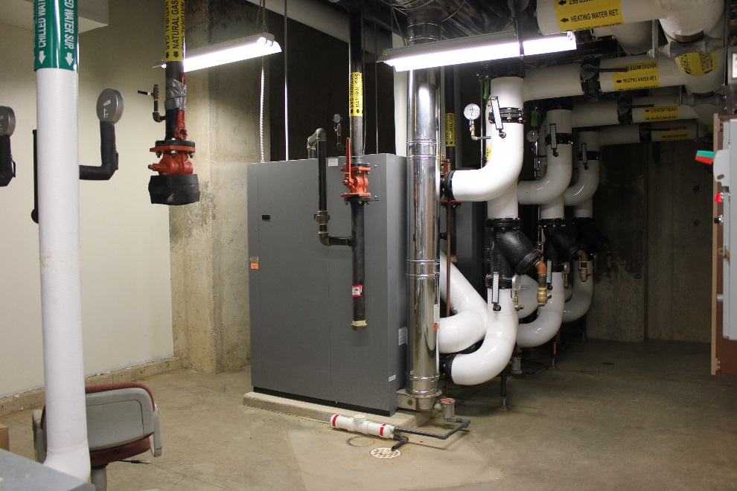
Table of Contents
RGE Standalone Utilities
Introduction
Project Overview
Existing Systems
  Existing Infrastructure
  Water-side HVAC
  Air-side HVAC
  Design Conditions
  Design Objectives
Proposal
Depth: Cogeneration Plant Implementation
Breadth 1: Power Interconnect and Black Start Capability
Breadth 2: Alternate Project Delivery System
Final Recommendations
Conclusion/Acknowledgements
Image © Scheeser Buckley Mayfield LLC
Image © Scheeser Buckley Mayfield LLC
Notes:
Project Overview: Project Background
Location
Campus
Phase 1
RGE
CMU
REDI-Zone
The Village
Phase 2
NEW
Phase 3

Slide 11
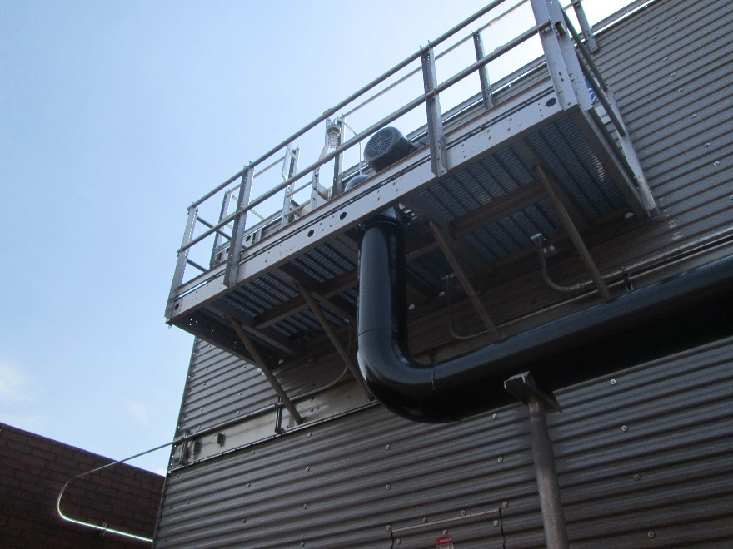
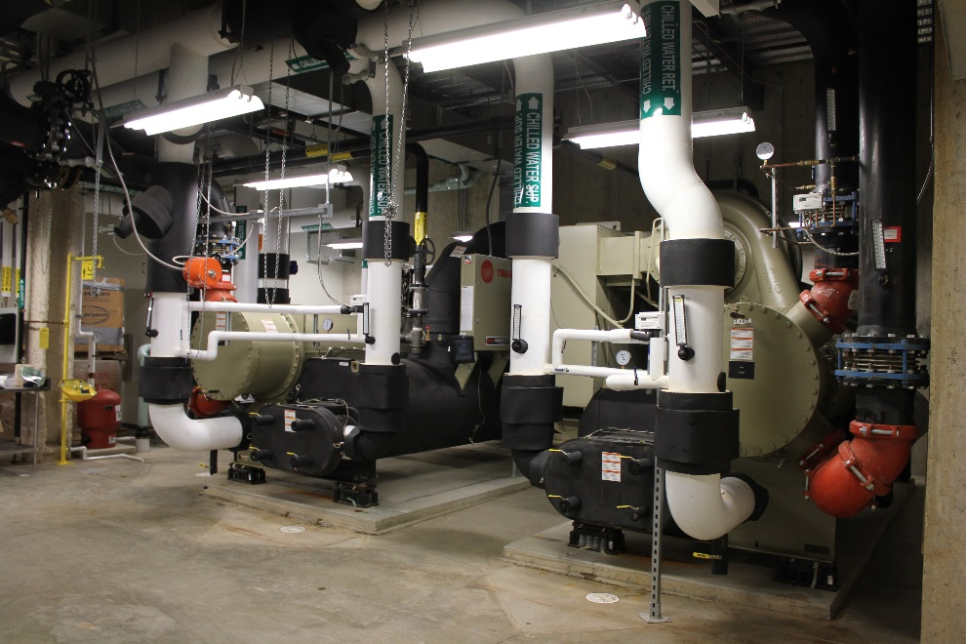
Table of Contents
RGE Standalone Utilities
Introduction
Project Overview
Existing Systems
  Existing Infrastructure
  Water-side HVAC
  Air-side HVAC
  Design Conditions
  Design Objectives
Proposal
Depth: Cogeneration Plant Implementation
Breadth 1: Power Interconnect and Black Start Capability
Breadth 2: Alternate Project Delivery System
Final Recommendations
Conclusion/Acknowledgements
Image © Scheeser Buckley Mayfield LLC
Image © Scheeser Buckley Mayfield LLC
Notes:
Project Overview: Project Background
Location
Campus
Phase 1
RGE
CMU
REDI-Zone
The Village
Phase 2
NEW
Phase 3

Slide 12
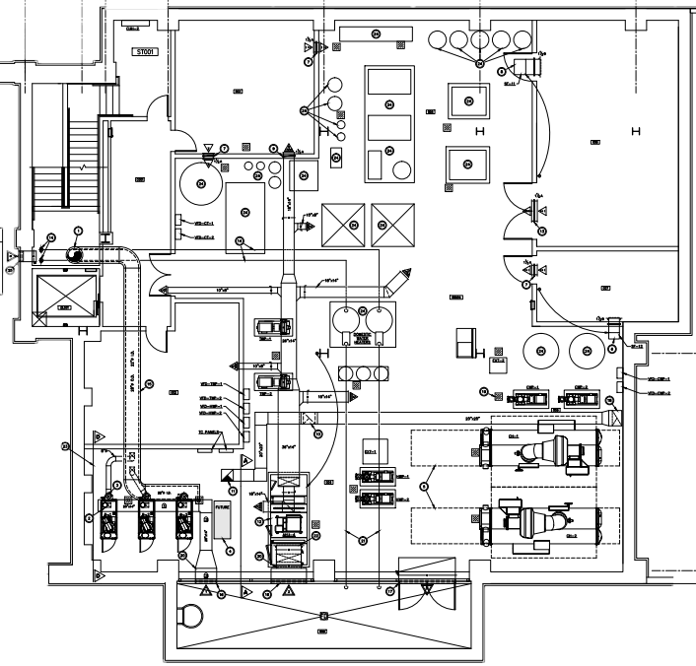
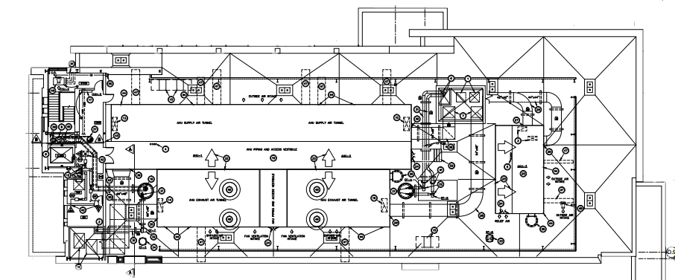
Table of Contents
Custom RTU’s
AHU-1 and AHU-2
50,000 CFM
100% OA
Introduction
Project Overview
Existing Systems
  Existing Infrastructure
  Water-side HVAC
  Air-side HVAC
  Design Conditions
  Design Objectives
Proposal
Depth: Cogeneration Plant Implementation
Breadth 1: Power Interconnect and Black Start Capability
Breadth 2: Alternate Project Delivery System
Final Recommendations
Conclusion/Acknowledgements
AHU-4
8,400 CFM
AHU-3
28,000 CFM
Notes:
Project Overview: Project Background
Location
Campus
Phase 1
RGE
CMU
REDI-Zone
The Village
Phase 2
NEW
Phase 3

Slide 13
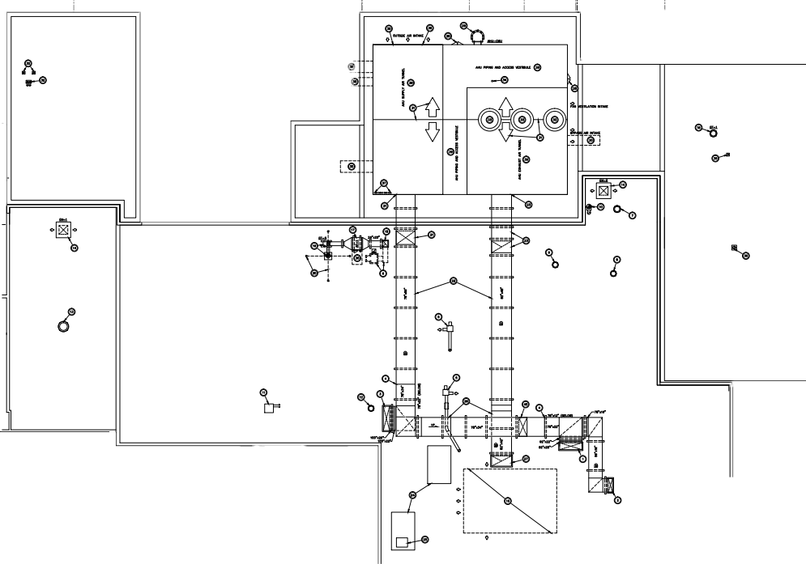
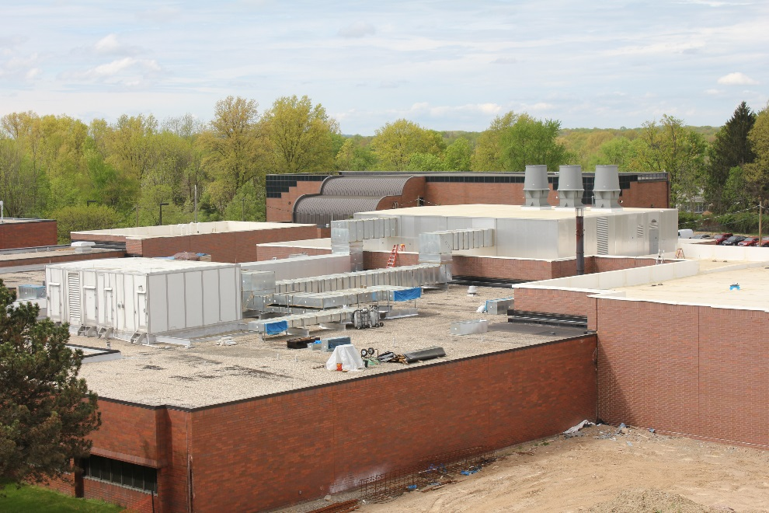
Table of Contents
Custom RTU’s
Introduction
Project Overview
Existing Systems
  Existing Infrastructure
  Water-side HVAC
  Air-side HVAC
  Design Conditions
  Design Objectives
Proposal
Depth: Cogeneration Plant Implementation
Breadth 1: Power Interconnect and Black Start Capability
Breadth 2: Alternate Project Delivery System
Final Recommendations
Conclusion/Acknowledgements
AHU-5
85,000 CFM
100% OA
Image © Scheeser Buckley Mayfield LLC
Notes:
Project Overview: Project Background
Location
Campus
Phase 1
RGE
CMU
REDI-Zone
The Village
Phase 2
NEW
Phase 3

Slide 14
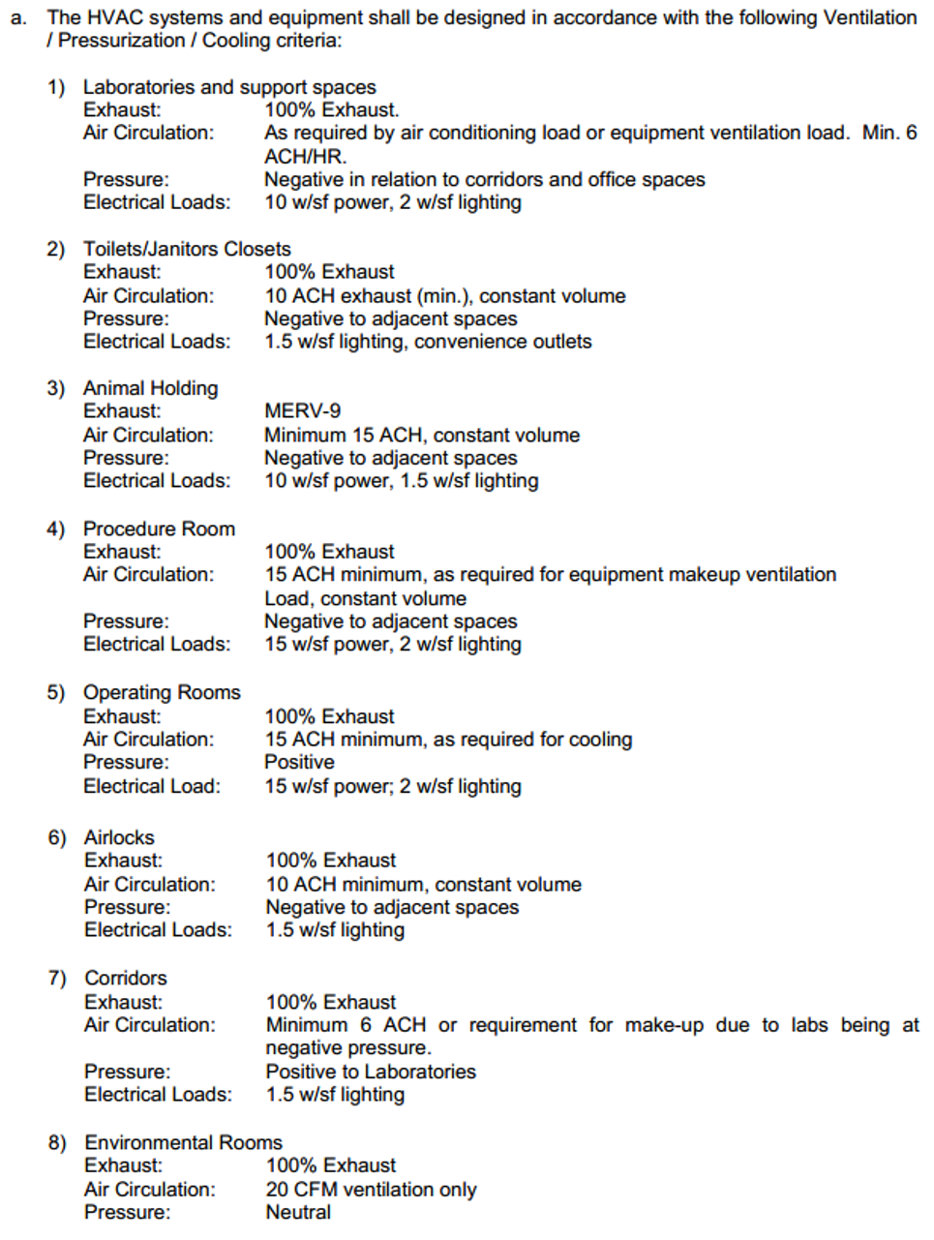
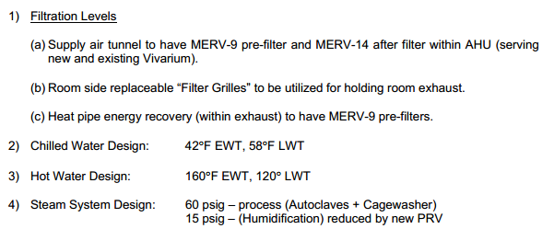
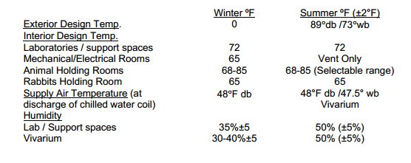
Table of Contents
Design Conditions
Introduction
Project Overview
Existing Systems
  Existing Infrastructure
  Water-side HVAC
  Air-side HVAC
  Design Conditions
  Design Objectives
Proposal
Depth: Cogeneration Plant Implementation
Breadth 1: Power Interconnect and Black Start Capability
Breadth 2: Alternate Project Delivery System
Final Recommendations
Conclusion/Acknowledgements
Image © BR+A Consulting Engineers
Image © BR+A Consulting Engineers
Image © BR+A Consulting Engineers
Notes:
Project Overview: Project Background
Location
Campus
Phase 1
RGE
CMU
REDI-Zone
The Village
Phase 2
NEW
Phase 3

Slide 15




Table of Contents
Design Objectives
Introduction
Project Overview
Existing Systems
  Existing Infrastructure
  Water-side HVAC
  Air-side HVAC
  Design Conditions
  Design Objectives
Proposal
Depth: Cogeneration Plant Implementation
Breadth 1: Power Interconnect and Black Start Capability
Breadth 2: Alternate Project Delivery System
Final Recommendations
Conclusion/Acknowledgements
Top-Notch Quality of Facility
24/7 Availability for Staff and Researchers
Image © <http://microinnova.com>
Image © <http://www.transactbookkeeping.co.uk/images/reliability.jpg>
Independence and Reliability of Building Systems
Flexibility for Future Changes and Campus Expansion
Image © <http://davegreenwald.com>
Image © <http://www.laborcosting.com>
Notes:
Project Overview: Project Background
Location
Campus
Phase 1
RGE
CMU
REDI-Zone
The Village
Phase 2
NEW
Phase 3

Slide 16
Table of Contents
Considerations Made
Introduction
Project Overview
Existing Systems
Proposal
  Decision Factors
  Proposal Components
Depth: Cogeneration Plant Implementation
Breadth 1: Power Interconnect and Black Start Capability
Breadth 2: Alternate Project Delivery System
Final Recommendations
Conclusion/Acknowledgements
High Air Turnover, Need for Energy Recovery
Multi-Phase, Multiple Bids
Complex Controls and Metering
Distance to Existing Utilities
Strict Technical Requirements
Environmental Impact
Ease of Maintenance
Goal of Long-Term Growth and Development
Strict Project Delivery Timeline
Cost Impact
Efficiency
Atypical Building Systems
Built to Benefit not only Students and Researchers but Entire Regional Community
Notes:
Project Overview: Project Background
Location
Campus
Phase 1
RGE
CMU
REDI-Zone
The Village
Phase 2
NEW
Phase 3

Slide 17
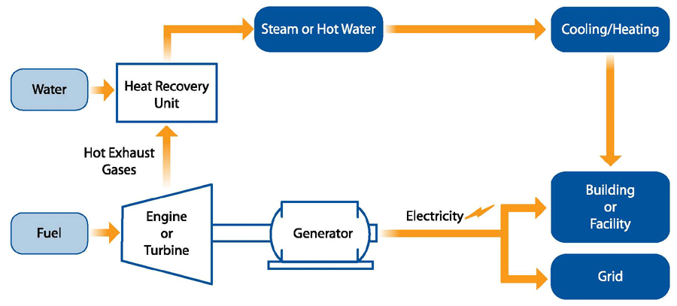
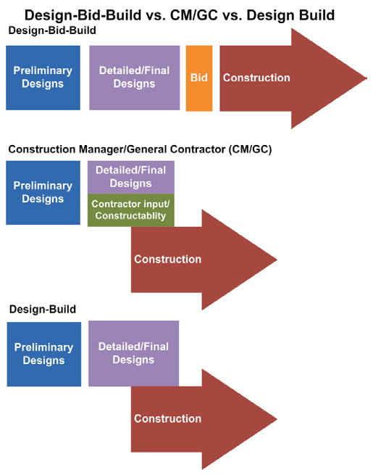

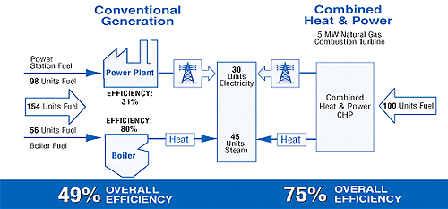
Table of Contents
Proposed Alternatives
Introduction
Project Overview
Existing Systems
Proposal
  Decision Factors
  Proposal Components
Depth: Cogeneration Plant Implementation
Breadth 1: Power Interconnect and Black Start Capability
Breadth 2: Alternate Project Delivery System
Final Recommendations
Conclusion/Acknowledgements
Breadth 1: Power Interconnect &
Black Start Capability
Breadth 2: Alternate Project
Delivery System
Depth: Cogeneration Plant Implementation
Image © <http://www-tc.pbs.org>
Image © <http://www.fhwa.dot.gov>
Image © <http://www.epa.gov>
Notes:
Project Overview: Project Background
Location
Campus
Phase 1
RGE
CMU
REDI-Zone
The Village
Phase 2
NEW
Phase 3

Slide 18
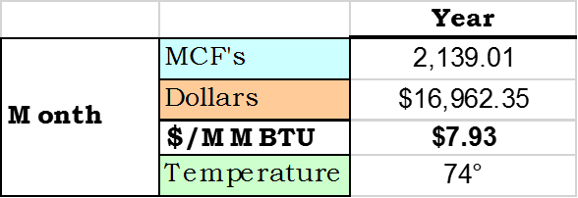
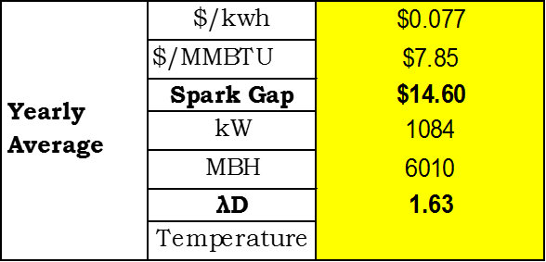
Table of Contents
Campus Utility Data
Introduction
Project Overview
Existing Systems
Proposal
Depth: Cogeneration Plant Implementation
  Utility Data Analysis
  Screening
  Configuration Analyses
  System Operation
  Further Expansion
Breadth 1: Power Interconnect and Black Start Capability
Breadth 2: Alternate Project Delivery System
Final Recommendations
Conclusion/Acknowledgements
Notes:
Project Overview: Project Background
Location
Campus
Phase 1
RGE
CMU
REDI-Zone
The Village
Phase 2
NEW
Phase 3

Slide 19
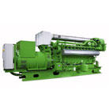
Table of Contents
System Selection
Site Data Collection
1. How many hours per year does the facility operate? (hours) Or, ask about operating schedule - day/week, hours/day |  |  |  |  |  |  |  |  |  |  |  | 8,760
2. What is your average power demand during operation? (kW), or |  |  |  |  |  |  |  |  |  |  |  | 1,084
3. How much electricity do you use in a year, kWh? |  |  |  |  |  |  |  |  |  |  |  | 9,369,859
4. What is your facility's primary thermal load (i.e., DHW, steam/HW space heating, process steam, cooling, etc.) |  |  |  |  |  |  |  |  |  |  |  | Space Heating
5. What is your average thermal demand? (MMBtu/hr), or |  |  |  |  |  |  |  |  |  |  |  | 6.01
6. How much fuel (gas/oil/etc) do you use in a year? (MMBtu/yr, Therms/yr, etc.) |  |  |  |  |  |  |  |  |  |  |  | 51,922
7. What is your current fuel price? ($/MMBtu) |  |  |  |  |  |  |  |  |  |  |  | $7.850
8. How much do you pay for fuel annually? (Dollars/yr) |  |  |  |  |  |  |  |  |  |  |  | $405,770
9. What are the CHP Fuel Costs? ($/MMBtu) |  |  |  |  |  |  |  |  |  |  |  | $7.850
10. What is your average electricity price? ($/kWh) |  |  |  |  |  |  |  |  |  |  |  | $0.077
11. How much do you pay for electricity annually? (Dollars/yr) |  |  |  |  |  |  |  |  |  |  |  | $712,509
12. What is the efficiency of your existing boiler(s)/thermal equipment? (decimal) |  |  |  |  |  |  |  |  |  |  |  | 0.90 | RGE HW Boiler
13. What is the efficiency of your existing chillers? (kWh/ton) |  |  |  |  |  |  |  |  |  |  |  | 0.60 | RGE Chiller
Introduction
Project Overview
Existing Systems
Proposal
Depth: Cogeneration Plant Implementation
  Utility Data Analysis
  Screening
  Configuration Analyses
  System Operation
  Further Expansion
Breadth 1: Power Interconnect and Black Start Capability
Breadth 2: Alternate Project Delivery System
Final Recommendations
Conclusion/Acknowledgements
GE Jenbacher Reciprocating Engine
 | Based on Recip Engines |  |  |  | Based on Gas Turbines
Thermal Output, MMBtu/hr | 0.34 | 2.64 | 3.85 | 10.67 | 24.47 | 52.62 | 76.42 | 141.33
Net Capacity, kW | 50 | 600 | 1,000 | 3,300 | 5,000 | 10,000 | 20,000 | 45,000
System | A | B | C | D | E | F | G | H
Heat Rate, Btu/kWh | 12,637 | 9,896 | 9,264 | 8,454 | 11,807 | 12,482 | 10,265 | 9,488
Net Electrical Efficiency, % | 27.0% | 34.5% | 36.8% | 40.4% | 28.9% | 27.3% | 33.2% | 36.0%
Thermal Output, Btu/kWh | 6,700 | 4,392 | 3,854 | 3,233 | 4,893 | 5,262 | 3,821 | 3,141
Thermal Output, MMBtu/hr | 0.34 | 2.64 | 3.85 | 10.67 | 24.47 | 52.62 | 76.42 | 141.33
Thermal Output for Cooling (single effect) | 80% | 85% | 85% | 85% | 100% | 100% | 100% | 100%
Thermal Output for Cooling (double effect) | 50% | 50% | 50% | 50% | 90% | 90% | 90% | 90%
Total Efficiency, % | 80% |  | 78% | 79% | 70% | 69% | 70% | 69%
Incremental O&M, $/kWh | $0.0240 | $0.0210 | $0.0190 | $0.0126 | $0.0123 | $0.0120 | $0.0093 | $0.0092
Total Installed Costs, $/kW | $2,900 | $2,737 | $2,335 | $1,917 | $2,080 | $1,976 | $1,518 | $1,248
CHP System
Net CHP Power, kW | 1,084 |  | CHP System Specs | C
CHP Electric Efficiency, % (HHV) | 36.8% |  | CHP system specs | C
CHP Thermal Output, Btu/kWh | 3,854 |  | CHP system specs | C
CHP Thermal Output, MMBtu/hr | 4.2 |  | CHP system specs | C
CHP Power to Heat Ratio | 0.89 |  | Calculated based on CHP power output and thermal output
CHP Availability, % | 98% |  | 90 to 98%
Incremental O&M Costs, $/kWh | $0.019 |  | CHP system specs | C
Thermal Utilization, % | 90% |  | Amount of available thermal captured and used - typically 80 to 100%
Total Installed Costs, $/kW | $2,335 |  | CHP system specs | C
Image © <http://site.ge-energy.com/prod_serv/products/recip_engines/en/type3.htm>
Notes:
Project Overview: Project Background
Location
Campus
Phase 1
RGE
CMU
REDI-Zone
The Village
Phase 2
NEW
Phase 3

Slide 20
Table of Contents
System Sizing
Introduction
Project Overview
Existing Systems
Proposal
Depth: Cogeneration Plant Implementation
  Utility Data Analysis
  Screening
  Configuration Analyses
  System Operation
  Further Expansion
Breadth 1: Power Interconnect and Black Start Capability
Breadth 2: Alternate Project Delivery System
Final Recommendations
Conclusion/Acknowledgements
Notes:
Project Overview: Project Background
Location
Campus
Phase 1
RGE
CMU
REDI-Zone
The Village
Phase 2
NEW
Phase 3

Slide 21
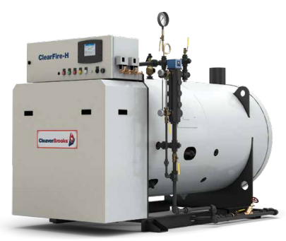
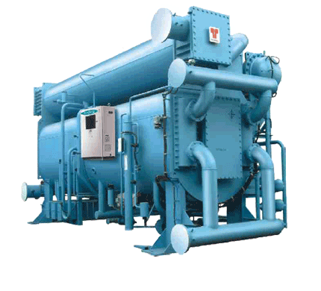
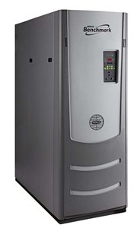
Table of Contents
Configurations
Introduction
Project Overview
Existing Systems
Proposal
Depth: Cogeneration Plant Implementation
  Utility Data Analysis
  Screening
  Configuration Analyses
  System Operation
  Further Expansion
Breadth 1: Power Interconnect and Black Start Capability
Breadth 2: Alternate Project Delivery System
Final Recommendations
Conclusion/Acknowledgements
Year-Round
Cooling
Heating
Cooling
Heating
Image © Cleaver Brooks Product Literature
Image © Trane Product Literature
Image © AERCO Product Literature
Makeup
Notes:
Project Overview: Project Background
Location
Campus
Phase 1
RGE
CMU
REDI-Zone
The Village
Phase 2
NEW
Phase 3

Slide 22
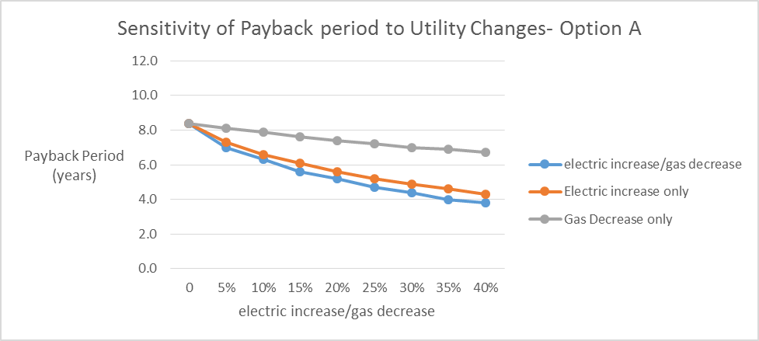
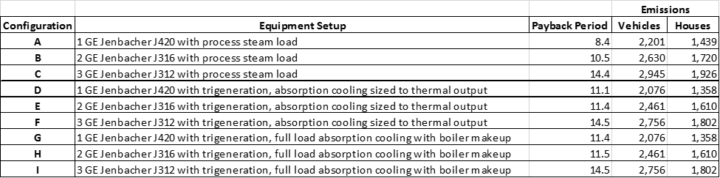
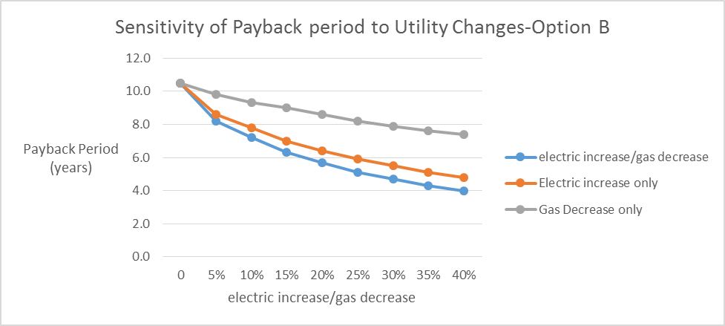
Table of Contents
Configuration Analysis
Introduction
Project Overview
Existing Systems
Proposal
Depth: Cogeneration Plant Implementation
  Utility Data Analysis
  Screening
  Configuration Analyses
  System Operation
  Further Expansion
Breadth 1: Power Interconnect and Black Start Capability
Breadth 2: Alternate Project Delivery System
Final Recommendations
Conclusion/Acknowledgements
Plant Configuration Results
Notes:
Project Overview: Project Background
Location
Campus
Phase 1
RGE
CMU
REDI-Zone
The Village
Phase 2
NEW
Phase 3

Slide 23
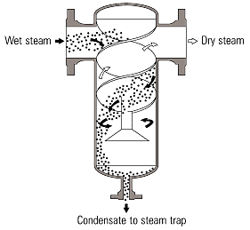
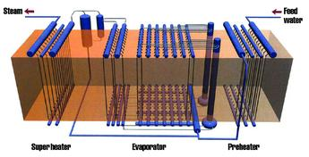
Table of Contents
Cogeneration System Schematic
Introduction
Project Overview
Existing Systems
Proposal
Depth: Cogeneration Plant Implementation
  Utility Data Analysis
  Screening
  Configuration Analyses
  System Operation
  Further Expansion
Breadth 1: Power Interconnect and Black Start Capability
Breadth 2: Alternate Project Delivery System
Final Recommendations
Conclusion/Acknowledgements
High-Temperature Water Steam System
Image © <http://www.davegreenwald.com>
Once-Trough Steam Generator
Image © <http://inproheat.com/sites/files/imagecache/product_nodeview/products/pic-onceThrough-zz_0.jpg>
Notes:
Project Overview: Project Background
Location
Campus
Phase 1
RGE
CMU
REDI-Zone
The Village
Phase 2
NEW
Phase 3

Slide 24
Table of Contents
Further Expansion
Introduction
Project Overview
Existing Systems
Proposal
Depth: Cogeneration Plant Implementation
  Utility Data Analysis
  Screening
  Configuration Analyses
  System Operation
  Further Expansion
Breadth 1: Power Interconnect and Black Start Capability
Breadth 2: Alternate Project Delivery System
Final Recommendations
Conclusion/Acknowledgements
Generator Sizing Accommodates Expansion
  Fit out of 4th Floor
  AHU Humidifiers
Locate Additional Plant Capacity in NEW Building
  Lap Pool
  Hydrotherapy Pool
Image © <http://www.neomed.edu/about/pdfs/neomed-campus-map.pdf>
Notes:
Project Overview: Project Background
Location
Campus
Phase 1
RGE
CMU
REDI-Zone
The Village
Phase 2
NEW
Phase 3

Slide 25
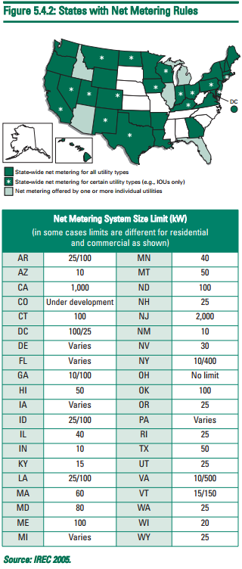
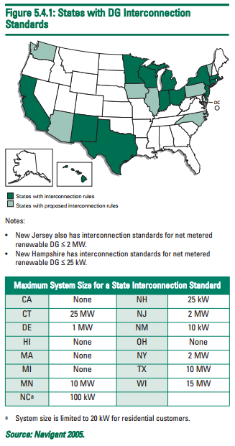
Table of Contents
State Interconnect Laws and Standards
Introduction
Project Overview
Existing Systems
Proposal
Depth: Cogeneration Plant Implementation
Breadth 1: Power Interconnect and Black Start Capability
  Interconnect Laws and Standards
  Utility Interconnect Design
  Black Start Capability
Breadth 2: Alternate Project Delivery System
Final Recommendations
Conclusion/Acknowledgements
Ohio has very “DG-Friendly” Policies
Disconnect Switch at discretion of Utility
No Generation System Size Limit for Interconnection
Net Metering mandated for all IOU’s; No Generation System Size Limit
Image © EPA Clean Energy-Environment Guide to Action
Image © EPA Clean Energy-Environment Guide to Action
Notes:
Project Overview: Project Background
Location
Campus
Phase 1
RGE
CMU
REDI-Zone
The Village
Phase 2
NEW
Phase 3

Slide 26
Table of Contents
Generation and Utility Parallel Operation Schematic
Introduction
Project Overview
Existing Systems
Proposal
Depth: Cogeneration Plant Implementation
Breadth 1: Power Interconnect and Black Start Capability
  Interconnect Laws and Standards
  Utility Interconnect Design
  Black Start Capability
Breadth 2: Alternate Project Delivery System
Final Recommendations
Conclusion/Acknowledgements
Notes:
Project Overview: Project Background
Location
Campus
Phase 1
RGE
CMU
REDI-Zone
The Village
Phase 2
NEW
Phase 3

Slide 27
Table of Contents
Project Delivery Methods
Introduction
Project Overview
Existing Systems
Proposal
Depth: Cogeneration Plant Implementation
Breadth 1: Power Interconnect and Black Start Capability
Breadth 2: Alternate Project Delivery System
  Background
  Research
  Potential Benefits
Final Recommendations
Conclusion/Acknowledgements
Notes:
Project Overview: Project Background
Location
Campus
Phase 1
RGE
CMU
REDI-Zone
The Village
Phase 2
NEW
Phase 3

Slide 28
Table of Contents
Project Delivery Methods
Introduction
Project Overview
Existing Systems
Proposal
Depth: Cogeneration Plant Implementation
Breadth 1: Power Interconnect and Black Start Capability
Breadth 2: Alternate Project Delivery System
  Background
  Research
  Potential Benefits
Final Recommendations
Conclusion/Acknowledgements
Notes:
Project Overview: Project Background
Location
Campus
Phase 1
RGE
CMU
REDI-Zone
The Village
Phase 2
NEW
Phase 3

Slide 29
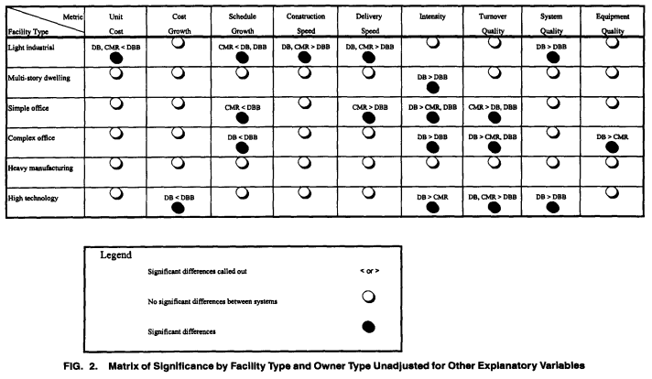
Table of Contents
Research Results
Introduction
Project Overview
Existing Systems
Proposal
Depth: Cogeneration Plant Implementation
Breadth 1: Power Interconnect and Black Start Capability
Breadth 2: Alternate Project Delivery System
  Background
  Research
  Potential Benefits
Final Recommendations
Conclusion/Acknowledgements
Univariate Results
50% CMR and DB delivered on-time or early
50% DBB more than 4% late
CMR,DB Quality > DBB Quality
Multivariate Results
DB < CMR DBB
Delivery Method significant influence on construction speed, some influence on total delivery speed
Delivery Method single biggest influence on schedule growth
Project Delivery Method biggest influence on every metric overall, matched only by Facility Type
Image © Journal of Construction Engineering and Management Nov/Dec 1998
Notes:
Project Overview: Project Background
Location
Campus
Phase 1
RGE
CMU
REDI-Zone
The Village
Phase 2
NEW
Phase 3

Slide 30
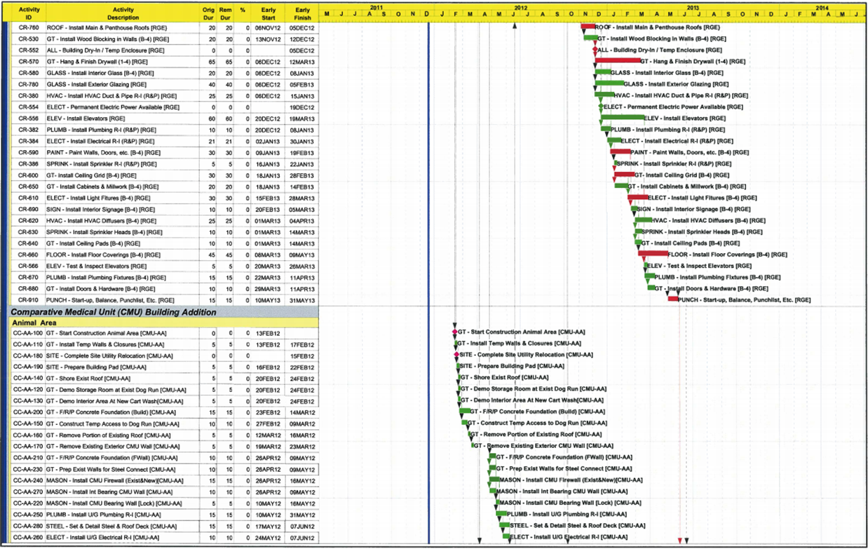
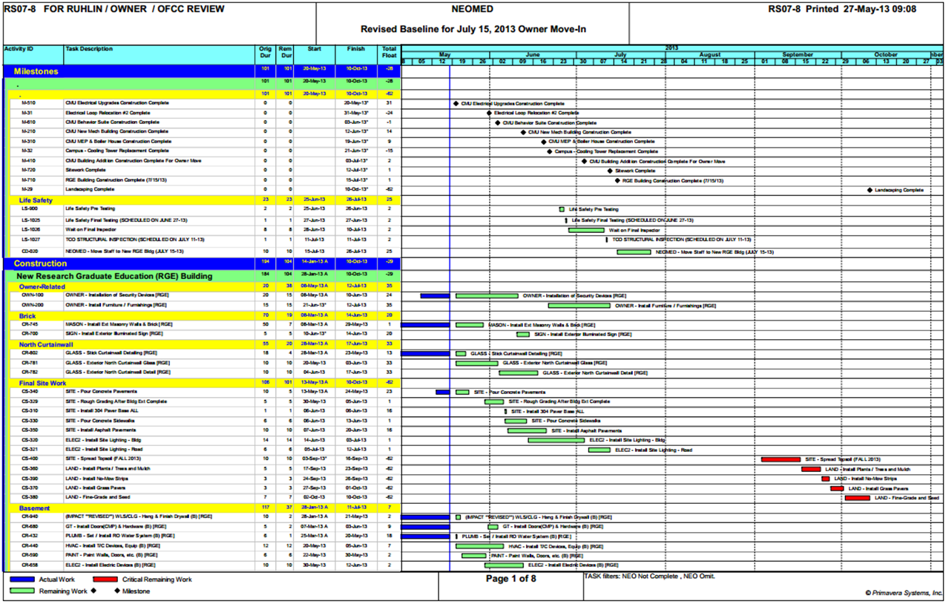
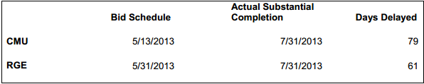
Table of Contents
Project Benefits
Introduction
Project Overview
Existing Systems
Proposal
Depth: Cogeneration Plant Implementation
Breadth 1: Power Interconnect and Black Start Capability
Breadth 2: Alternate Project Delivery System
  Background
  Research
  Potential Benefits
Final Recommendations
Conclusion/Acknowledgements
Schedule Slippage
Images © the Ruhlin Group, NEOMED University
Notes:
Project Overview: Project Background
Location
Campus
Phase 1
RGE
CMU
REDI-Zone
The Village
Phase 2
NEW
Phase 3

Slide 31
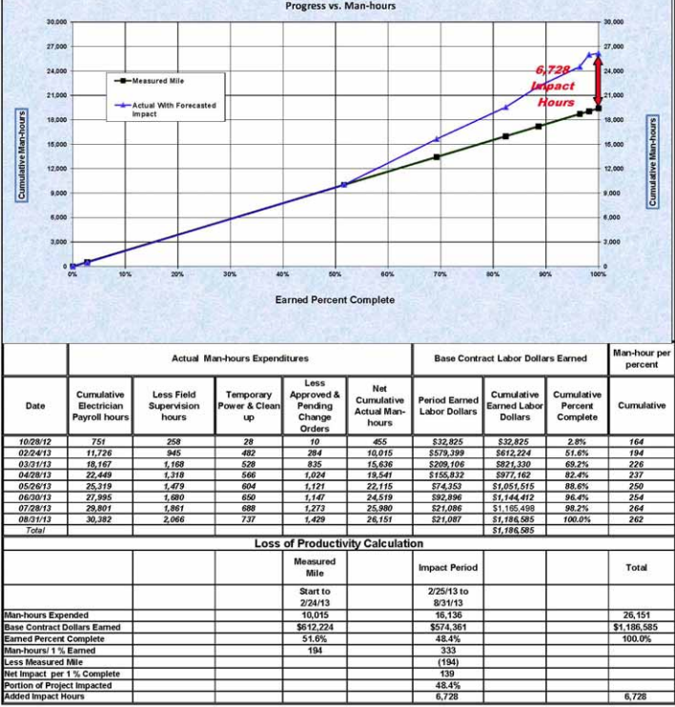
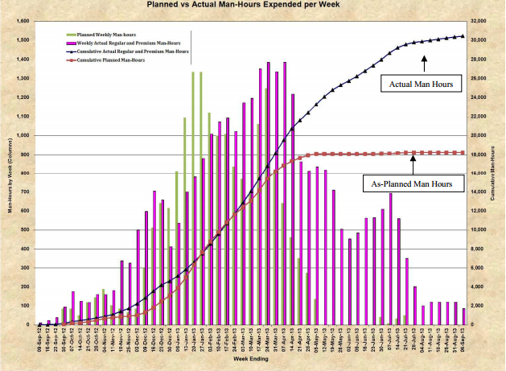
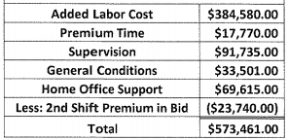

Table of Contents
Project Benefits
Introduction
Project Overview
Existing Systems
Proposal
Depth: Cogeneration Plant Implementation
Breadth 1: Power Interconnect and Black Start Capability
Breadth 2: Alternate Project Delivery System
  Background
  Research
  Potential Benefits
Final Recommendations
Conclusion/Acknowledgements
Disputes
Images © the Ruhlin Group, NEOMED University
Notes:
Project Overview: Project Background
Location
Campus
Phase 1
RGE
CMU
REDI-Zone
The Village
Phase 2
NEW
Phase 3

Slide 32

Table of Contents
Final Recommendations Based On Analyses
Introduction
Project Overview
Existing Systems
Proposal
Depth: Cogeneration Plant Implementation
Breadth 1: Power Interconnect and Black Start Capability
Breadth 2: Alternate Project Delivery System
Final Recommendations
Conclusion/Acknowledgements
Breadth 1: Power Interconnect &
Black Start Capability
Breadth 2: Alternate Project
Delivery System
Depth: Cogeneration Plant Implementation
Notes:
Project Overview: Project Background
Location
Campus
Phase 1
RGE
CMU
REDI-Zone
The Village
Phase 2
NEW
Phase 3

Slide 33






Table of Contents
Acknowledgements
Introduction
Project Overview
Existing Systems
Proposal
Depth: Cogeneration Plant Implementation
Breadth 1: Power Interconnect and Black Start Capability
Breadth 2: Alternate Project Delivery System
Final Recommendations
Conclusion/Acknowledgements
Chris Schoonover | Principal - Scheeser Buckley Mayfield, LLC
Brian Ault | Mechanical Engineer - Scheeser Buckley Mayfield, LLC
Blaine Wyckoff | Director of Campus Operations- Northeast Ohio Medical University
Jim Rankin | Asst. Dir. of Campus Operations- Northeast Ohio Medical University
Jim Freihaut | Professor of Architectural Engineering – Penn State
Rob Leicht | Asst. Professor of Architectural Engineering – Penn State
Tim Warren | President - JDB Engineering, Inc.
Tom Leary | Executive VP/DOP - JDB Engineering, Inc.
Ari Tinkoff | Managing Director/Principal - BR+A Consulting Engineers
Scott Walthour | Managing Principal – Arium AE
Chris Elgin | Structural Engineer - GPD Group
Diet Mt. Dew | Carbonated Soft Drink – PepsiCo Inc.
Steam | Internet-based gaming platform – Valve Corporation
Notes:
Project Overview: Project Background
Location
Campus
Phase 1
RGE
CMU
REDI-Zone
The Village
Phase 2
NEW
Phase 3

